Slide 1
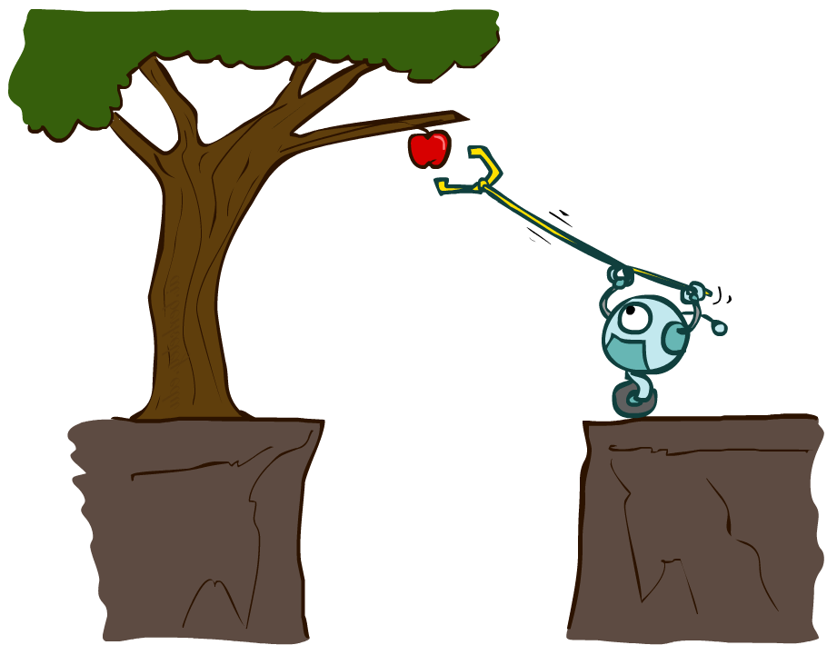
CS 188: Artificial Intelligence
Agents and environments
Notes:
Please retain proper attribution and the reference to ai.berkeley.edu. Thanks!

Slide 2
Outline
Agents and environments
Rationality
PEAS (Performance measure, Environment, Actuators, Sensors)
Environment types
Agent types

Slide 3
Agents and environments
Agent
Environment
Sensors
Percepts
?
Actuators
Actions
An agent perceives its environment through sensors and acts upon it through actuators (or effectors, depending on whom you ask)

Slide 4
Agents and environments
Agent
Environment
Sensors
Percepts
?
Actuators
Actions
Are humans agents?
Yes!
Sensors = vision, audio, touch, smell, taste, proprioception
Actuators = muscles, secretions, changing brain state

Slide 5
Agents and environments
Agent
Environment
Sensors
Percepts
?
Actuators
Actions
Are pocket calculators agents?
Yes!
Sensors = key state sensors
Actuators = digit display

Slide 6
Agents and environments
Agent
Environment
Sensors
Percepts
?
Actuators
Actions
AI is more interested in agents with large computational resources and environments that require nontrivial decision making

Slide 7
Agent functions
The agent function maps from percept histories to actions:
f : P* → A
I.e., the agent’s actual response to any sequence of percepts
Percept
NEXT
NEXT
NEXT
NEXT
Action
LEFT
LEFT
DROP
RIGHT
Notes:
Is there any reason to pay attention to more than just the current percept?
No – the correct decision depends only on the current percept because the world is fully observable!

Slide 8
Agent programs
The agent program l runs on some machine M to implement f :
f = Agent(l,M)
Real machines have limited speed and memory, introducing delay, so agent function f depends on M as well as l
Percept
NEXT
NEXT
NEXT
NEXT
Action
NOOP
NOOP
NOOP
LEFT

Slide 9
Agent functions and agent programs
Can every agent function be implemented by some agent program?
No! Consider agent for halting problems, NP-hard problems, chess with a slow PC

Slide 10
Example: Vacuum world
Percepts: [location,status], e.g., [A,Dirty]
Actions: Left, Right, Suck, NoOp

Slide 11
Vacuum cleaner agent
Agent function
Agent program
Percept sequence | Action
[A,Clean] | Right
[A,Dirty] | Suck
[B,Clean] | Left
[B,Dirty] | Suck
[A,Clean],[B,Clean] | Left
[A,Clean],[B,Dirty] | Suck
etc | etc
function Reflex-Vacuum-Agent([location,status])
returns an action
if status = Dirty then return Suck
else if location = A then return Right
else if location = B then return Left
What is the right agent function?
Can it be implemented by a small agent program?
(Can we ask, “What is the right agent program?”)

Slide 12
Rationality
Fixed performance measure evaluates the environment sequence
one point per square cleaned up?
NO! Rewards an agent who dumps dirt and cleans it up
one point per clean square per time step, for t = 1,…,T
A rational agent chooses whichever action maximizes the expected value of the performance measure
given the percept sequence to date and prior knowledge of environment
Does Reflex-Vacuum-Agent implement a rational agent function?
Yes, if movement is free, or new dirt arrives frequently
Notes:
The dirt-dumping problem is an example of the King Midas problem – mis-specifying the objective

Slide 13
Rationality, contd.
Are rational agents 无所不能?
No – they are limited by the available percepts
Are rational agents 明察秋毫?
No – they may lack knowledge of the environment dynamics
Do rational agents explore and learn?
Yes – in unknown environments these are essential
Do rational agents make mistakes?
No – but their actions may be unsuccessful
Are rational agents autonomous (i.e., transcend initial program)?
Yes – as they learn, their behavior depends more on their own experience

Slide 14
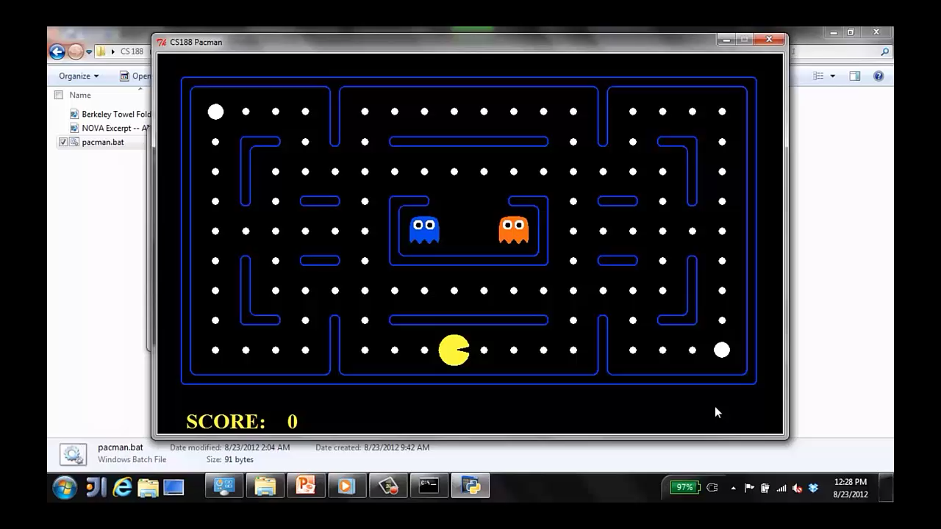
A human agent in Pacman

Slide 15
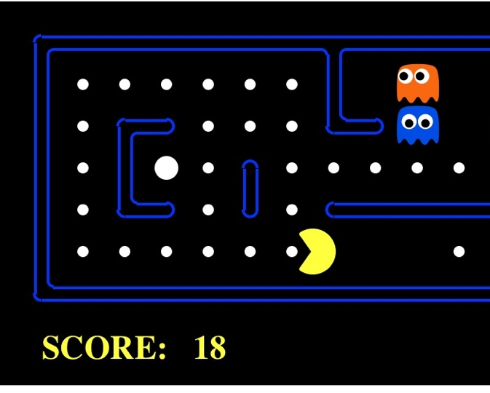
The task environment - PEAS
Performance measure
-1 per step; + 10 food; +500 win; -500 die; +200 hit scared ghost
Environment
Pacman dynamics (incl ghost behavior)
Actuators
Left Right Up Down
Sensors
Entire state is visible (except power pellet duration)

Slide 16
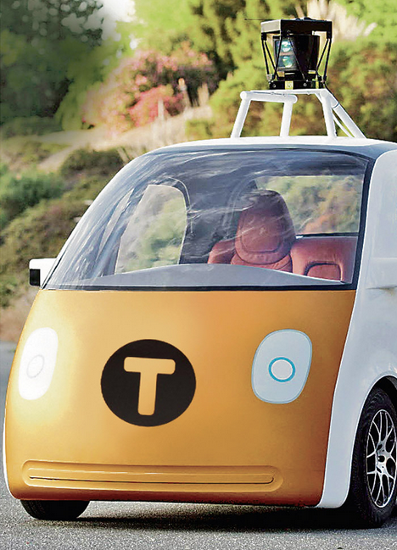
PEAS: Automated taxi
Performance measure
Income, happy customer, vehicle costs, fines, insurance premiums
Environment
US streets, other drivers, customers, weather, police…
Actuators
Steering, brake, gas, display/speaker
Sensors
Camera, radar, accelerometer, engine sensors, microphone, GPS
Image: http://nypost.com/2014/06/21/how-google-might-put-taxi-drivers-out-of-business/

Slide 17

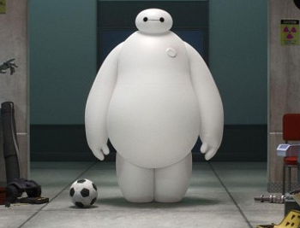
PEAS: Medical diagnosis system
Performance measure
Patient health, cost, reputation
Environment
Patients, medical staff, insurers, courts
Actuators
Screen display, email
Sensors
Keyboard/mouse

Slide 18
Environment types
 | Pacman | Backgammon | Diagnosis | Taxi
Fully or partially observable
Single-agent or multiagent
Deterministic or stochastic
Static or dynamic
Discrete or continuous
Known physics?
Known perf. measure?

Slide 19
Agent design
The environment type largely determines the agent design
Partially observable => agent requires memory (internal state)
Stochastic => agent may have to prepare for contingencies
Multi-agent => agent may need to behave randomly
Static => agent has time to compute a rational decision
Continuous time => continuously operating controller
Unknown physics => need for exploration
Unknown perf. measure => observe/interact with human principal

Slide 20
Agent types
In order of increasing generality and complexity
Simple reflex agents （单反射性智能主体）
Model-based reflex agents（基于模型的反射性智能主体）
Goal-based agents （基于目标的智能主体）
Utility-based agents （基于效用的智能主体）

Slide 21
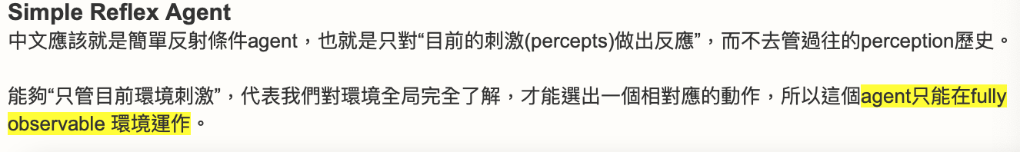
单反射性智能主体

Slide 22
Pacman agent in Python
class GoWestAgent(Agent):
def getAction(self, percept):
if Directions.WEST in percept.getLegalPacmanActions():
return Directions.WEST
else:
return Directions.STOP

Slide 23
Pacman agent contd.
Can we (in principle) extend this reflex agent to behave well in all standard Pacman environments?
No – Pacman is not quite fully observable (power pellet duration)
Otherwise, yes – we can (in principle) make a lookup table…..
Notes:
106 locations so 106^3 * 2^106 (ignoring power pellet stuff) =~ 10^38 states
Worse if the map is not fixed – all possible physics? No – can simply say 3^150 or whatever

Slide 24
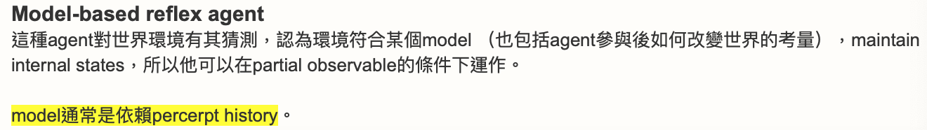
基于模型的反射性智能主体

Slide 25
基于目标的智能主体
基于目标的智能主体更像是基于模型的反射性智能主体的升级版。通常在对周围环境感知不足的情况下使用。智能主体讲目标（goal）的信息和模型的信息相结合。采取最接近goal的行动。
Notes:
Act to achieve a goal
Pro: use goal to index into actions that might achieve it, eg “Have milk” -> “buy milk”
Con: cannot handle tradeoffs among goals, failure probability etc.

Slide 26
基于效用的智能主体
Notes:
Utility is a numeric scale
Pro: can compute expected values for actions, handle tradeoffs and uncertainty
Con: cannot (easily) index into actions

Slide 27
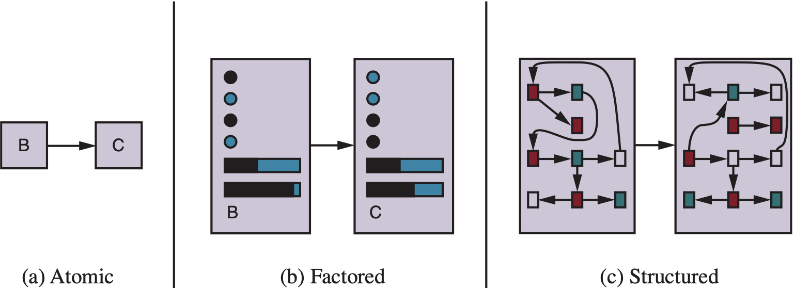
Spectrum of representations

Slide 28
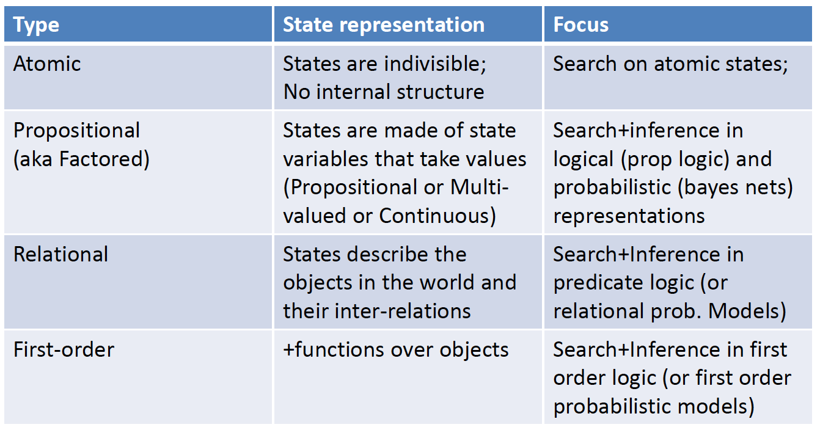
Spectrum of representations

Slide 29
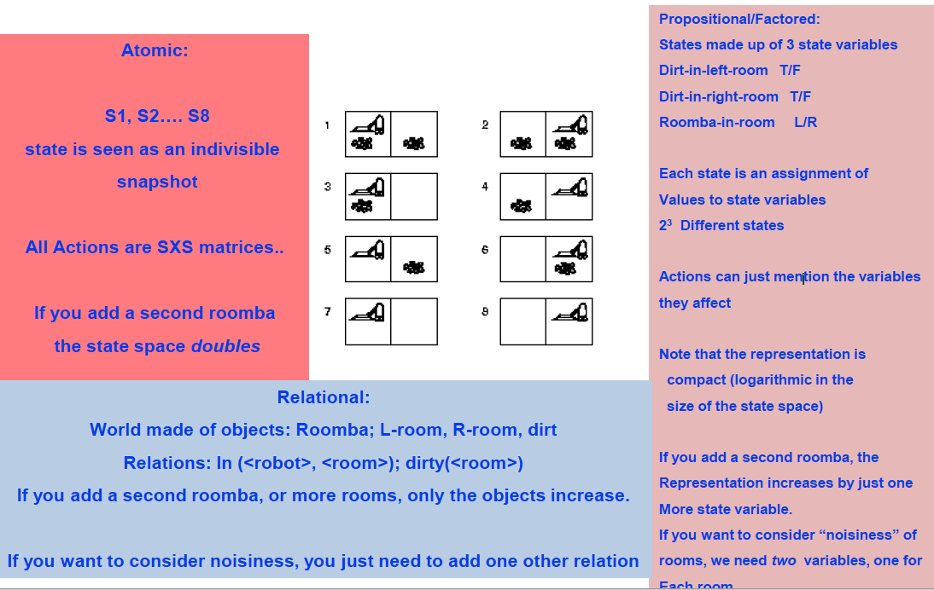
Illustration with vacuum world

Slide 30
Summary
An agent interacts with an environment through sensors and actuators
The agent function, implemented by an agent program running on a machine, describes what the agent does in all circumstances
Rational agents choose actions that maximize their expected utility
PEAS descriptions define task environments; precise PEAS specifications are essential and strongly influence agent designs
More difficult environments require more complex agent designs and more sophisticated representations

Slide 31
Outline of the course
unknown
RL
known
deterministic
stochastic
atomic
SEARCH
MDPs
factored
LOGIC
Bayes nets
structured
First-order logic

